Slide 1
PHYS 304: Lecture 6 (Intro to) Quantum Mechanics
Sept-Dec 2021 Edition
Jeff Young
brimacombe Rm 278, young@phas.ubc.ca

Slide 2

Review of key point from last day
The normalized solutions of the time-independent Schrödinger equation for an infinite square well potential outside of 0 < x < a, the $ψ_{n}(x)=\sqrt{\frac{2}{a}} sin(\frac{nπ}{a}x)$for n=1, 2, …., form an orthonormal and complete set of functions in the region 0 < x < a, that are zero on the boundaries.

Slide 3
Today
Complete the recipe for solving the full Schrödinger
Solve a dynamical problem where the wavefunction is not just a stationary eigenstate.

Slide 4
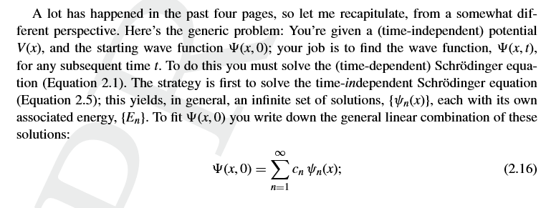
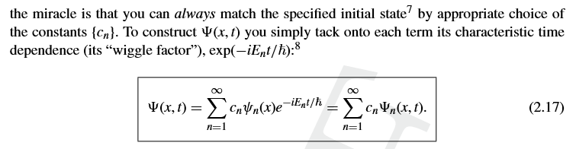
Recall
The algorithm (flowchart) for solving the full Schrödinger equation using separation of variables:
Notes:
This is THE INSTRUCTION MANUAL for quantum mechanics. For the rest of the course we have to get our heads around all its implications, and learn how to actually solve for the time-independent solutions in different cases.
Absolutely crucial that the c’s are all constant!!!
What has gone on here?
Assumed that there is a separable solution to the full SE
Derived 2 DEs that seem easier to solve than one PDE
Assume that these can be solved for an intimately connected pair of spatial and temporal functions that can each be normalized for an infinite set of values of En
Take it on faith from mathematicians that a general solution of the full SE can always be expanded as a linear combination of these stationary solutions, WITH CONSTANT COEFFICIENTS that can be determined by knowing the spatial variation of the full WF at any specific time.

Slide 5

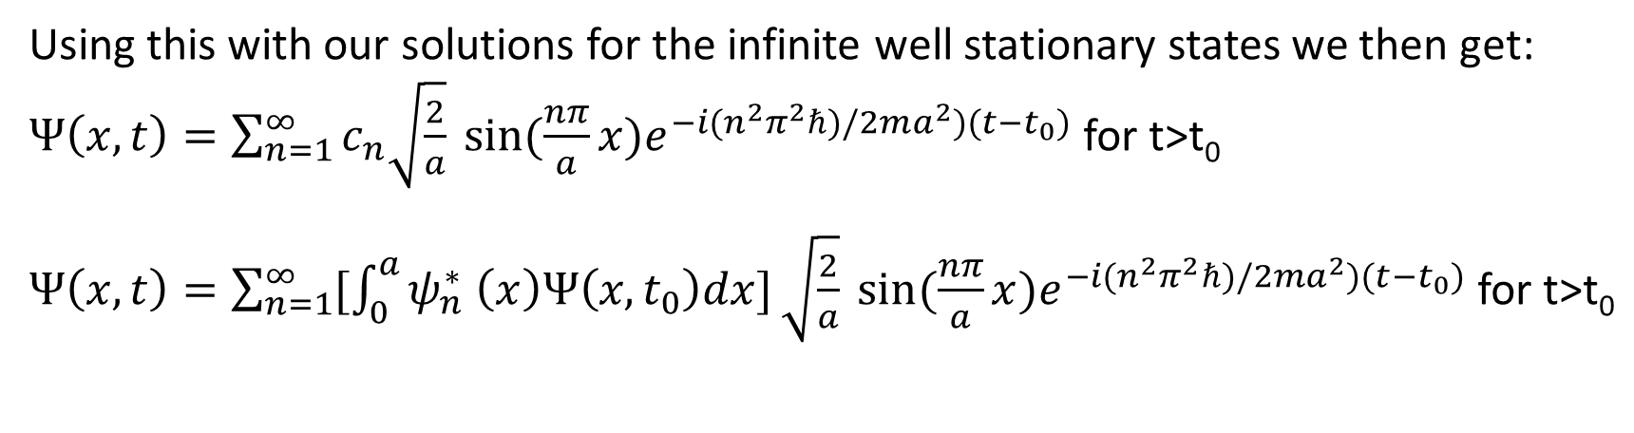
Complete the story for the infinite square well potential
The recipe for obtaining the expansion coefficients c_{n}, is:
$$c_{n}=\int_{0}^{a}{ψ_{n}^{∗} \left(x\right)Ψ\left(x,t_{0}\right)dx,}$$
Using this with our solutions for the infinite well stationary states we then get:
$Ψ\left(x,t\right)=\sum_{n=1}^{∞}{c_{n}\sqrt{\frac{2}{a}} sin(\frac{nπ}{a}x)e^{−i(n^{2}π^{2}ℏ)/2ma^{2})(t−t_{0})}}$ for t>t₀
$Ψ\left(x,t\right)=\sum_{n=1}^{∞}{[\int_{0}^{a}{ψ_{n}^{∗} \left(x\right)Ψ\left(x,t_{0}\right)dx]}\sqrt{\frac{2}{a}} sin(\frac{nπ}{a}x)e^{−i(n^{2}π^{2}ℏ)/2ma^{2})(t−t_{0})}}$ for t>t₀
Notes:
This equation is general, for any potential, if the range of integration goes from -\infty to +\infty
The eqn for c_n is the equivalent to the dot product in 2D real vector space.

Slide 6

Lets see how this works by solving for the: Dynamics of an electron in an infinite square well
V=infinity
V=infinity
V=0
x=0
x=a
Take the initial (t₀=0) wavefunction of particle in an infinite square well potential to be an equally weighted superposition of the lowest two stationary states:
$$Ψ\left(x,t=0\right)=\frac{1}{\sqrt{2}}(ψ_{1}\left(x\right)+ψ_{2}(x))$$
Notes:
Lets study the state evolution as a function of time (ie. Dynamics of an electron in this state at t=0)
Start by explicitly pointing out this corresponds to some initial (at t=0) wavefunction that just so happens to have only 2 non-zero inner product integrals with all of the (infinite in number) bases states.

Slide 7
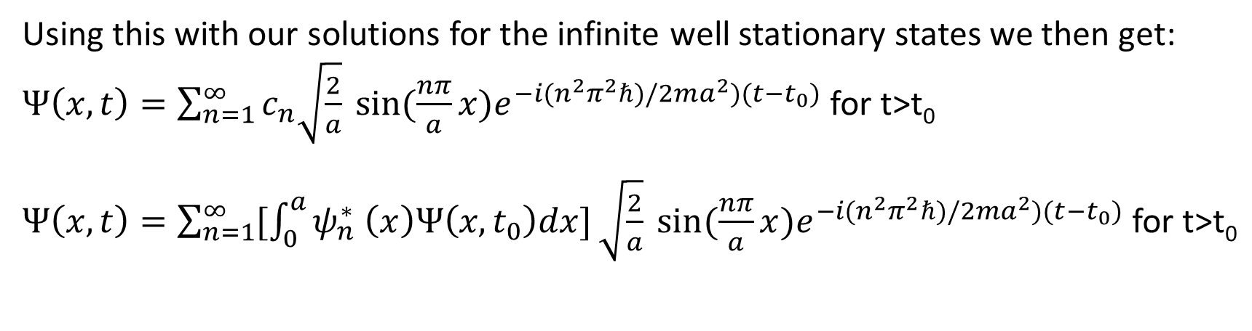
Lecture 6, Activity 1: (Rapid Response)
What are the coefficients c₁ and c₂ in the general form solution?
Using this with our solutions for the infinite well stationary states we then get:
$Ψ\left(x,t\right)=\sum_{n=1}^{∞}{c_{n}\sqrt{\frac{2}{a}} sin(\frac{nπ}{a}x)e^{−i(n^{2}π^{2}ℏ)/2ma^{2})(t−t_{0})}}$ for t>t₀
$Ψ\left(x,t\right)=\sum_{n=1}^{∞}{[\int_{0}^{a}{ψ_{n}^{∗} \left(x\right)Ψ\left(x,t_{0}\right)dx]}\sqrt{\frac{2}{a}} sin(\frac{nπ}{a}x)e^{−i(n^{2}π^{2}ℏ)/2ma^{2})(t−t_{0})}}$ for t>t₀

Slide 8
See Special Lecture Notes
Infinite_well_dynamics_2021.pdf

Slide 9
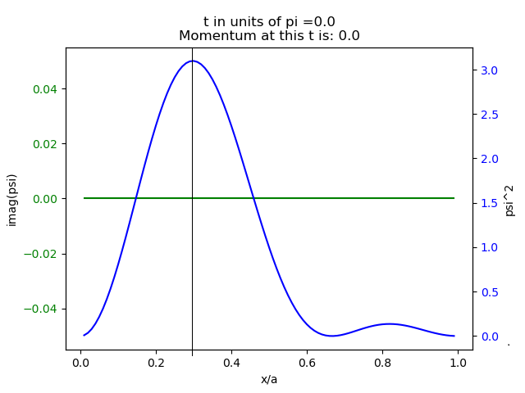
Sanity Check
Is our answer for the effective distance the particle travels from left to right reasonable?

